Slide 1
QSM algo ppt1
14 dec 2023

Slide 2
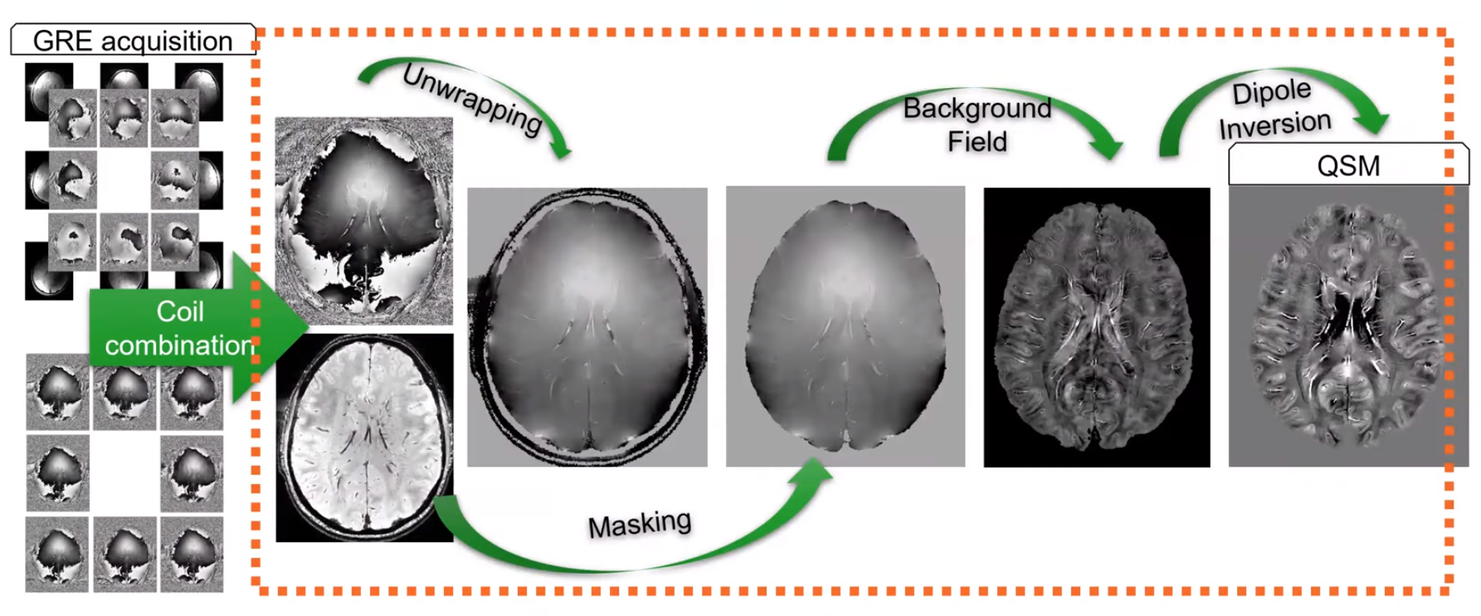
QSM general pipeline
From a mathematical point of view, a phase image can be expressed by the convolution between the magnetic susceptibility distribution and the dipole-shaped kernel. Thus, a QSM can be obtained by dipole inversion: for example, by dividing the phase by the dipole kernel in the Fourier domain. However, the dipole kernel in the Fourier domain has zeros along the conical surface, which makes the dipole inversion an ill-posed inverse problem.

Slide 3
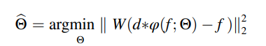
To solve this problem a popular method is to use multi orientation data in COSMOS method but this is impractical in clinical scenario. However, the derived QSM data is considered to be gold standard for any other comparison. Another solution is to use TKD but that requires heavy parameter twinning.
Deep learning methods work amazing however they are fragile when inconsistent data is given as input or a foreign pathology is introduced in testing without including it in train data. To solve this many partially or completely unsupervised methods are introduced. One such method is FINE (2020) (fidelity imposed network edit)
FINE improves the fidelity of test data by adapting the weights of a pre-trained CNN through backpropagation according to the physical model for each case in the test dataset.
However, Shadow artifacts have yet to be effectively suppressed by FINE. It also did not address U-Net’s structural inferiority to MoDL in the low noise level cases.

Slide 4
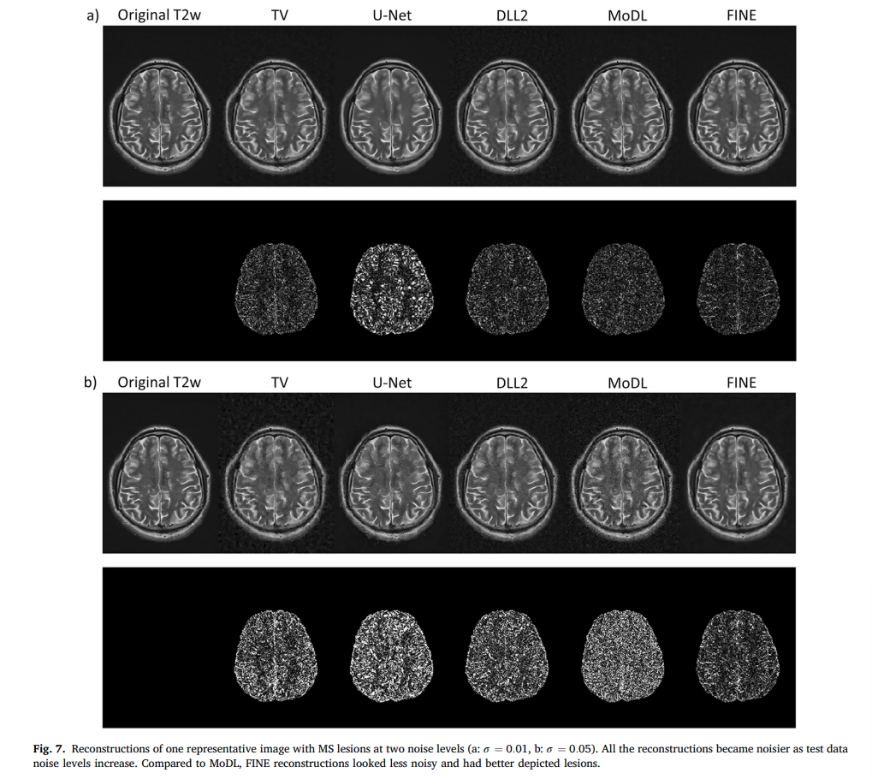
FINE (fidelity imposed network edit)
In the, building on the U-Net architecture (Ronneberger et al., 2015) as the reconstruction network, they proposed to update the weight. of a pre-trained U-Net for each case in the test dataset by minimizing an unsupervised fidelity loss function. The fidelity loss is defined according to the forward physical model and data noise property.
Despite the merits of minimal reconstruction error, some shadow artifacts near the CSF were introduced in FINE.

Slide 5
UraQSM: Unsupervised resolution-agnostic quantitative susceptibility mapping using adaptive instance normalization (2022)
Important novelties:
Completely unsupervised learning does not require QSM labels for training and reconstructs QSM with various resolutions by using adaptive instance normalization with a very fast speed.
The trained model is less sensitive to the lack of training data with enough variability and structures.
By employing AdaIN code generator, our method can be used for QSM reconstruction from any spatial resolution input data.
This method is a feed-forward neural network that provides instantaneous reconstruction once the training is done. This makes the algorithm very practical.

Slide 6
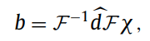
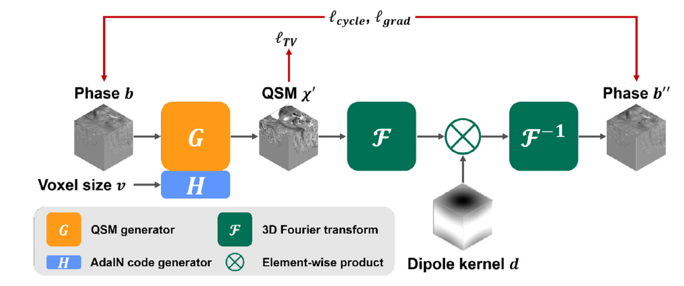
In the dipole inversion forward model, a phase image b ∈ B and a susceptibility map χ ∈ X correspond to a noisy measurement and an unobserved image, respectively. our goal is to reconstruct the susceptibility map (QSM) from the phase image using the neural network.
The role of the AdaIN code generator is to produce the mean and standard deviation for the AdaIN transform depending on the voxel size or the resolution of the input phase image. After generating the AdaIN code, the QSM generator receives the phase image and generated AdaIN code as inputs, and reconstructs the corresponding QSM.

Slide 7
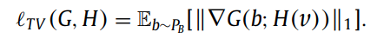
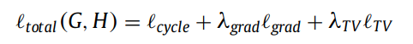
Cost functions:
cycle-consistency loss
gradient difference loss grad which was proposed in QSMnet(2018) to maintain the edge information, very high value will add noise
the total variation (TV) loss to preserve image details and remove noise in reconstructed QSM
Total loss

Slide 8
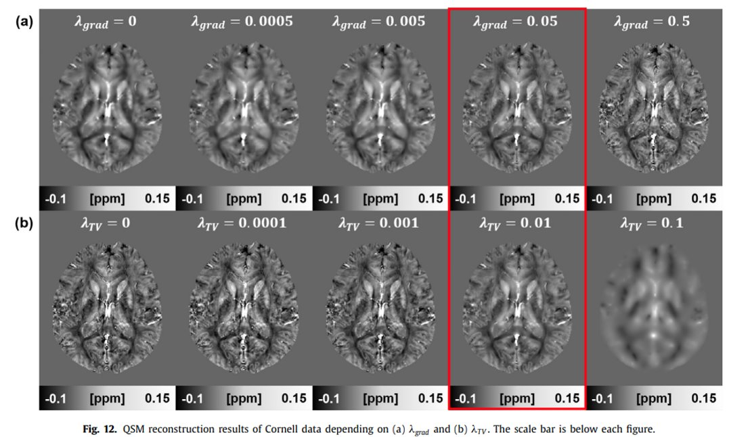
gradient difference loss grad

Slide 9
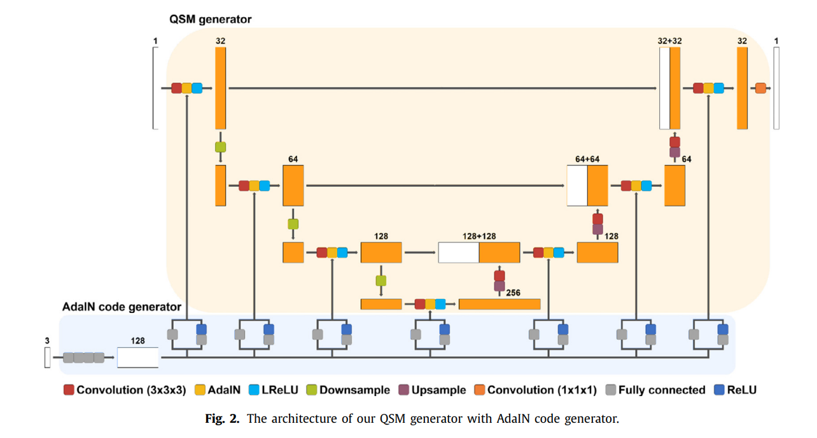
The QSM generator is constructed based on a 3D U-Net (Ronneberger et al., 2015) structure.
During the training, the phase volumes are randomly cropped to patches with the size of 64 × 64×64.
To train our networks, we use Adam optimizer with β1 = 0.5, β1 = 0.999,

Slide 10
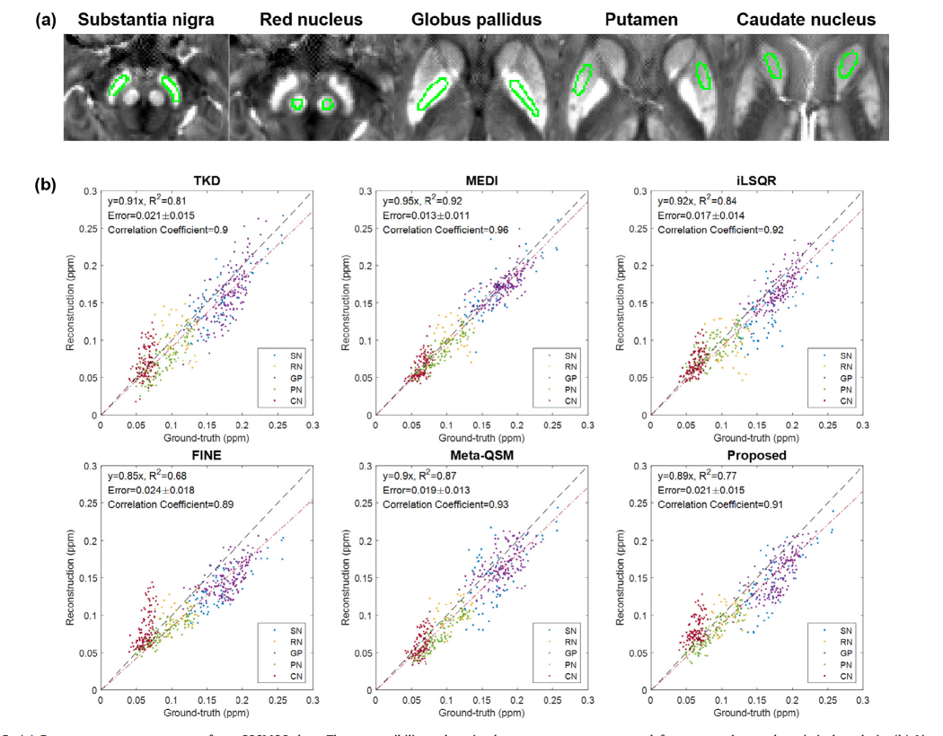

Slide 11
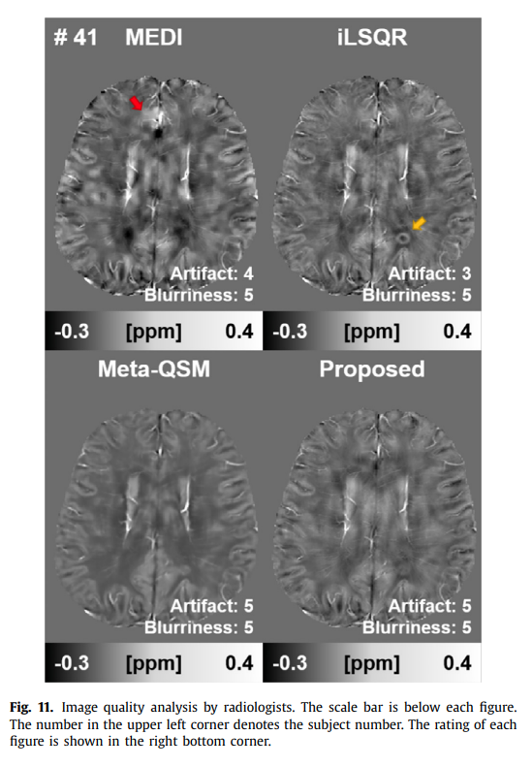
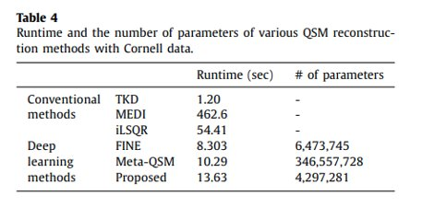

Slide 12
Datasets:
Preprocessing steps: background removal – SHARP
Train: 2016 QSM challenge, 2019 QSM challenge, resized data via interpolation for different resolutions
Evaluation: Data from Cornell MRI lab, KAIST MRI lab, KUH medical center
Limitation:
First, although they synthesized data with various resolutions by interpolation, it does not produce realistic data that has a different resolution from the original data.
Due to a limited number of data, they were not able to use the validation set for tuning hyper-parameters in the cost function.
It has inferior performance when the resolution of the test data is not used in training since the network cannot be used for that by simply adjusting the AdaIN code.

Slide 13
msQSM: Morphology-based self-supervised deep learning for quantitative susceptibility mapping (2023)
Important Novelties:
Morphological loss is effective in reducing streaking artifacts with less training time compared to the cycle gradient loss used in the previous unsupervised methods
msQSM can be applied to arbitrary resolution data, whereas using only one-resolution data needed for training.
By testing they claim this method is robust enough to measure significant increase in striatal magnetic susceptibility in patients during Alzheimer’s disease progression, as well as significant increase in substantia nigra susceptibility in Parkinson’s disease patients, and can be used as an auxiliary differential diagnosis tool for Alzheimer’s disease and Parkinson’s disease.

Slide 14
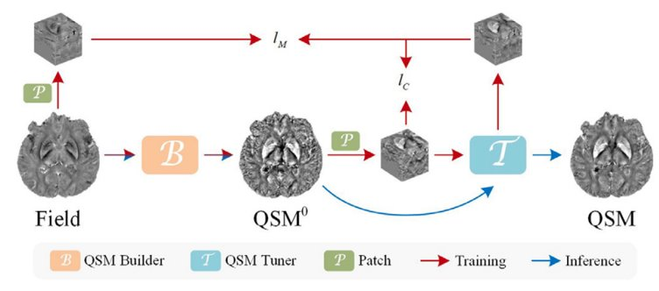
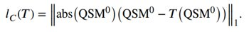
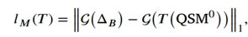
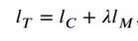
The builder receives a local field map to calculate a raw susceptibility mapping (QSM0). The tuner is a deep convolutional neural network trained to fine-tune QSM0 for improving the quality.
where 𝜆 denotes the weighting for 𝑙𝑀 , which was experimentally determined as 𝜆 = 0.01.

Slide 15
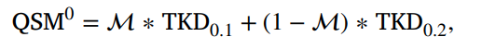
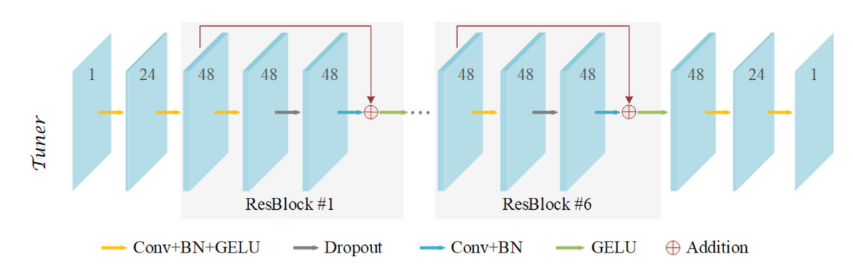
QSM builder, is proposed to reconstruct a raw QSM based on TKD. The builder is formulated as
𝑡ℎ𝑟 = 0.2 gave reasonable streaking artifact level, 𝑡ℎ𝑟 = 0.1 provided more accurate susceptibility values but with more streaking artifacts. proposed QSM builder can reconstruct susceptibility values with a low level of streaking artifacts and high accuracy, especially in the rapidly changing susceptibility regions. However, the result still contains streaking artifacts inherited from TKD0.1. Therefore, they propose a QSM tuner to fine-tune the raw susceptibility mapping.
The QSM tuner parameters were optimized using the Adam optimizer with 𝛽1 = 0.9, 𝛽2 = 0.999

Slide 16
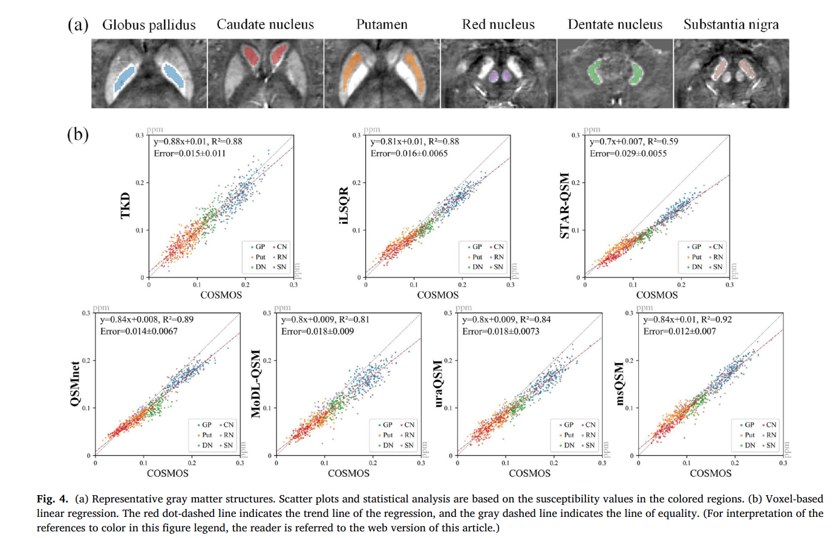

Slide 17
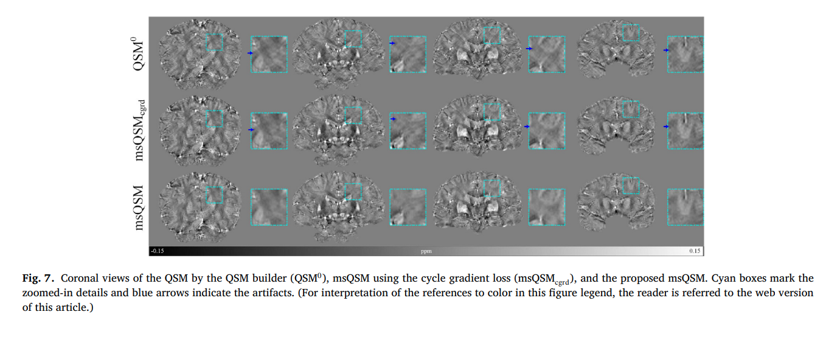
The zoomed in details outlined by cyan boxes reveal more clearly the existence of streaking artifacts in the results of QSM0 and msQSMcgrd, whereas these artifacts are effectively removed by msQSM.

Slide 18
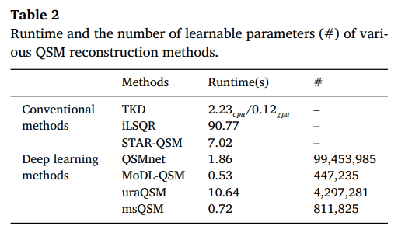
The proposed msQSM is 93.2% faster than uraQSM when reconstructing a QSM. One reason is that the model size of msQSM is much smaller than that of uraQSM. The other more important reason is that the test data need to be cropped into patches of size 64 × 64 × 64 with 50% overlap for uraQSM inference, whereas msQSM takes the full size of the test data to reconstruct without any cropping, which significantly reduces the calculation time.

Slide 19
Datasets:
Preprocessing steps: phase unwrapping – PRELUDE and background removal – V-SHARP
Train: In house data of 39 volunteers (available upon request), used in cropped patches of size 64^3
Evaluation: 2016 QSM challenge, Human data from QSM challenge 2.0 (2021), mouse data from STI Suite toolbox
Limitation:
Their method does not take noise into account; so, the anti-noise ability needs to be improved.

Slide 20
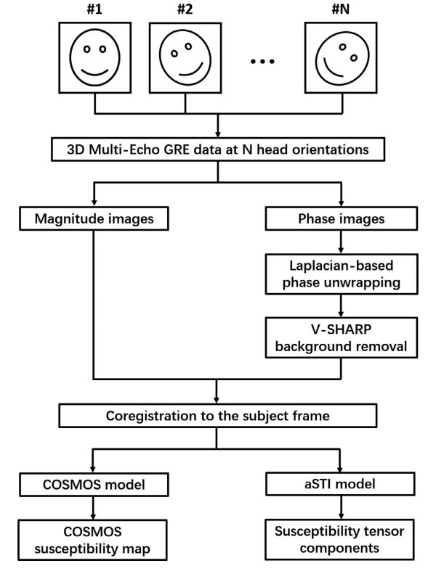
Towards in vivo ground truth susceptibility for single-orientation deep learning QSM: A multi-orientation gradient-echo MRI dataset (2022)
144 groups of local field maps from 8 subjects, COSMOS images and six symmetric susceptibility tensor components from 8 subjects are provided in this dataset along with raw GRE data

Slide 21
QSMxT (2021)
8 January, 2024
It is a robust QSM reconstruction pipeline across a range of acquisitions at 3 T in volunteers and phantoms, at 7 T in tumor patients, and in an in silico head phantom.

Slide 22
QSMxT: Robust masking and artifact reduction for quantitative susceptibility mapping (2021)
Why?
In the presence of a wide range of susceptibility sources, streaking artifacts appear around high susceptibility regions and contaminate the whole QSM map. Additionally, we may also experience banding artifacts. So we need a reliable masking technique to differentiate between reliable and unreliable signals.
Important novelties:
Two pass reconstruction method
No need for anatomical priors
Fully automated, free of parameter tuning

Slide 23
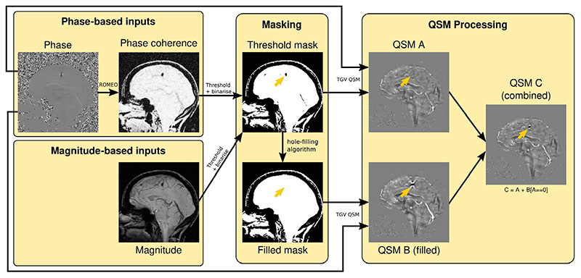
The phase unwrapping, background field removal, and dipole inversion steps are achieved using the TGV-QSM algorithm.
QSM reconstruction is achieved using a two-pass QSM procedure that performs two parallel QSM reconstructions per echo, with the first including more reliable susceptibility sources, and the second including reliable as well as less reliable sources

Slide 24
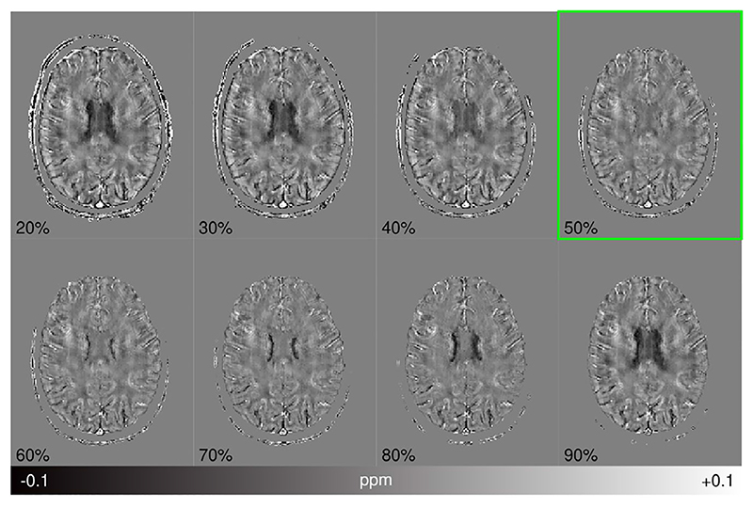
A closer look
The mask is produced by thresholding using a percentile of the signal distribution. It was set to 50th percentile from one trial. The thresholding operation automatically excludes areas with short T∗2 times, including strong and artifact-inducing susceptibility sources.
The second reconstruction uses the same set of masks after applying the hole-filling algorithm from Fslutils to fill any gaps from the first set, enabling less reliable sources to be included.
A combined QSM image is then produced by filling gaps from the first QSM image using the second. Finally a weighted average is produced by summing the combined QSMs and dividing them by the pixel-wise sum of the filled masks.

Slide 25
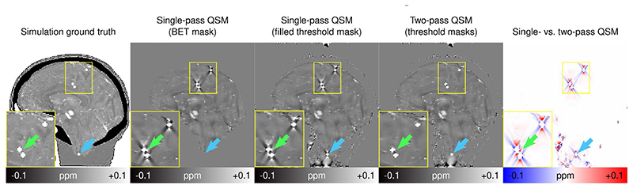
Two-pass QSM reduces streaking artifacts near the lesions (green arrow), and includes more anatomical detail in the brainstem due to threshold-based masking, allowing the brainstem lesion to be recovered (blue arrow).

Slide 26
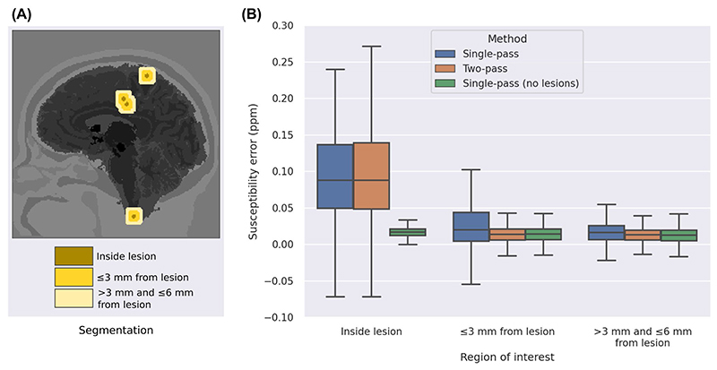
Limitations
And so in reconstructions where the lesion was present, the reconstruction error inside the lesion was higher

Slide 27
A thought?
TGV is known for systematically underestimating the susceptibility sources. Moreover, it is an iterative process to solve background field removal and dipole inversion together. But the computational cost is quite high. To overcome the computational cost, deep learning methods can be used. Many of these models however do not incorporate data-consistency constraints in the dipole inversion and hence may introduce hallucination effect.
I found such a end-to-end hybrid algorithm published in 2022, named as variational NEural network trained on compleX realistic strucTures for Quantitative Susceptibility Mapping (NeXtQSM). But they have used only simulated hybrid dataset to train and that is a gap we can work on.

Slide 28
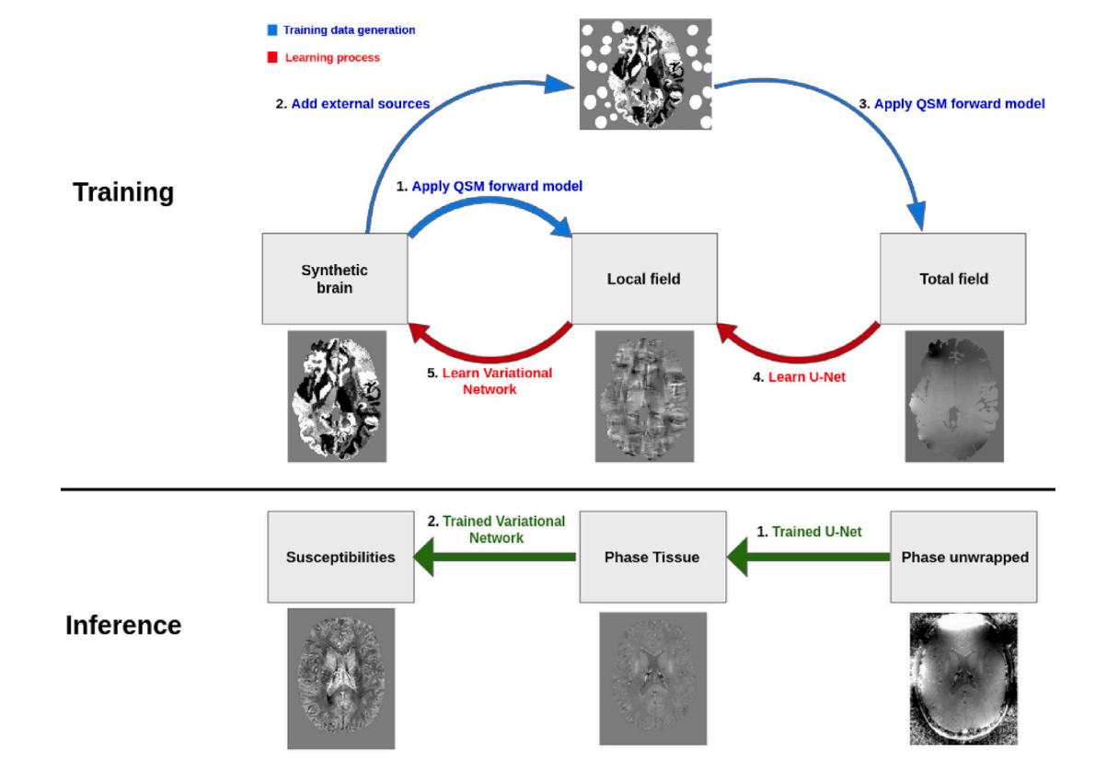
A thought?
TGV is known for systematically underestimating the susceptibility sources. Moreover, it is an iterative process to solve background field removal and dipole inversion together. But the computational cost is quite high. To overcome the computational cost, deep learning methods can be used. Many of these models however do not incorporate data-consistency constraints in the dipole inversion and hence may introduce hallucination effect.
I found such a end-to-end algorithm published in 2023, named as variational NEural network trained on compleX realistic strucTures for Quantitative Susceptibility Mapping (NeXtQSM). But they have used only simulated hybrid dataset to train and that is a gap we can work on.

Slide 29
Thank you, any questions?

